Slide 1
Memory Management Module 5
Operating Systems
Nadia Qureshi

Slide 3
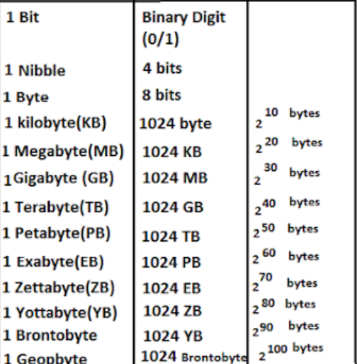
Paging Practice Problem
Assume a system with 4GB logical address space, 64 MB physical address space and 4kB page size. Calculate the no. of pages in page table? No. of frames in memory? Total no. of page table entries and size of the page table? For the given system the memory is byte addressable.
Byte addressable memory
Logical Address space (LAS) = 4GB
Physical Address Space (PAS) = 64MB
Page size = 4KB
No. of pages?
No. of frames?
No of page table entries?
Page table size?
2¹=2
2²=4
2³=8
2⁴=16
2⁵=32
2⁶=64
2⁷=128
2⁸=256
2⁹=512
2¹⁰⁼ IK (1024)
2²⁰=IM
2³⁰=IG
2⁴⁰=IT

Slide 4
Paging Practice Problem
Byte addressable memory
Logical Address space (LAS) = 4GB
Physical Address Space (PAS) = 64MB
Page size = 4KB
No. of pages?
No. of frames?
No of page table entries?
Page Table size?
Logical Address space (LAS) = 4GB
Logical address space Always represents size of the process
Whenever you are given LAS, convert it into logical address so that you have the exact no. of bits to represent the LAS ( 4GB in this case)
4GB = 2² 2³⁰ ⁼ 2³² (No need to convert B into bit as memory is byte addressable,
byte size and word size is usually same)
As we know that logical address is composed of p and d.
p is page no. and d is page offset or page size ( that is already given as 4KB, this again is size so we need to convert it into bits)
4KB = 2² 2¹⁰ ⁼ 2¹²
How many no. of Page = 2²⁰
2¹=2
2²=4
2³=8
2⁴=16
2⁵=32
2⁶=64
2⁷=128
2⁸=256
2⁹=512
2¹⁰⁼ IK (1024)
2²⁰=IM
2³⁰=IG
2⁴⁰=IT
Logical address – 32 bits
page number
page offset
p
d
LAS = 32 bits
p=20 bits
d=12 bits

Slide 5
Paging Practice Problem
Byte addressable memory
Logical Address space (LAS) = 4GB
Physical Address Space (PAS) = 64MB
Page size = 4KB
No. of pages?
No. of frames?
No of page table entries?
Page Table size?
In order to find No. of entries in page table we need to know the no. pages
No. of page table entries = No. of pages in a process
No of pages are already calculated as 2²⁰
So, No. of page tables are also 1M = 2²⁰
2¹=2
2²=4
2³=8
2⁴=16
2⁵=32
2⁶=64
2⁷=128
2⁸=256
2⁹=512
2¹⁰⁼ IK (1024)
2²⁰=IM
2³⁰=IG
2⁴⁰=IT

Slide 6
Paging Practice Problem
Byte addressable memory
Logical Address space (LAS) = 4GB
Physical Address Space (PAS) = 64MB
Page size = 4KB
No. of pages?
No. of frames?
No of page table entries?
Page Table size?
In order to find No. of frames we need Physical Address.
We are given Physical Address Space (PAS) = 64MB
Convert this size into no. of bits to represent the PAS
64MB = 2⁶ 2²⁰ ⁼ 2²⁶ (No need to convert B into bit as memory is byte addressable,
byte size and word size is usually same)
As we know that physical address is composed of f and d.
f is frame no. and d is frame offset ( page and frame offset/size are always same)
4KB = 2² 2¹⁰ ⁼ 2¹²
How many no. of frames = 2¹⁴
Physical address – 26 bits
2¹=2
2²=4
2³=8
2⁴=16
2⁵=32
2⁶=64
2⁷=128
2⁸=256
2⁹=512
2¹⁰⁼ IK (1024)
2²⁰=IM
2³⁰=IG
2⁴⁰=IT
frame number
frame offset
f
d
LAS = 26 bits
f=14 bits
d=12 bits

Slide 7
Paging Practice Problem
Byte addressable memory
Logical Address space (LAS) = 4GB
Physical Address Space (PAS) = 64MB
Page size = 4KB
No. of pages?
No. of frames?
No of page table entries?
Page Table size?
In order to find the size of entire page Table, we need to know the total No. of page tables are also 1M = 2²⁰
We calculated frame size as 14 bit
14 * 2²⁰
Page Table
14 bit frame size
2¹=2
2²=4
2³=8
2⁴=16
2⁵=32
2⁶=64
2⁷=128
2⁸=256
2⁹=512
2¹⁰⁼ IK (1024)
2²⁰=IM
2³⁰=IG
2⁴⁰=IT
1M = 2²⁰ entries

Slide 8
Implementation of Page Table
Page table is kept in main memory
Page-table base register (PTBR) points to the page table
Page-table length register (PTLR) indicates size of the page table
In this scheme every data/instruction access requires two memory accesses
One for the page table and one for the data / instruction
The two memory access problem can be solved by the use of a special fast-lookup hardware cache called associative memory or translation look-aside buffer (TLB)
Some TLBs store address-space identifiers (ASIDs) in each TLB entry – uniquely identifies each process to provide address-space protection for that process
Otherwise need to flush at every context switch
TLBs typically small (64 to 1,024 entries)
On a TLB miss, value is loaded into the TLB for faster access next time
Replacement policies must be considered
Some entries can be wired down for permanent fast access

Slide 9
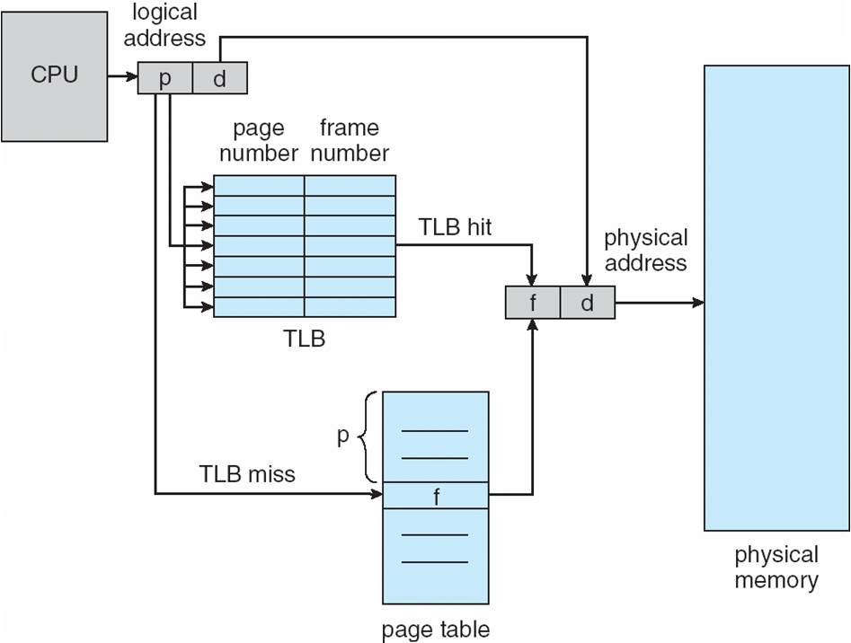
Paging Hardware With TLB

Slide 10
Memory Protection
Memory protection implemented by associating protection bit with each frame to indicate if read-only or read-write access is allowed
Can also add more bits to indicate page execute-only, and so on
Valid-invalid bit attached to each entry in the page table:
“valid” indicates that the associated page is in the process’ logical address space, and is thus a legal page
“invalid” indicates that the page is not in the process’ logical address space
Or use page-table length register (PTLR)
Any violations result in a trap to the kernel

Slide 11
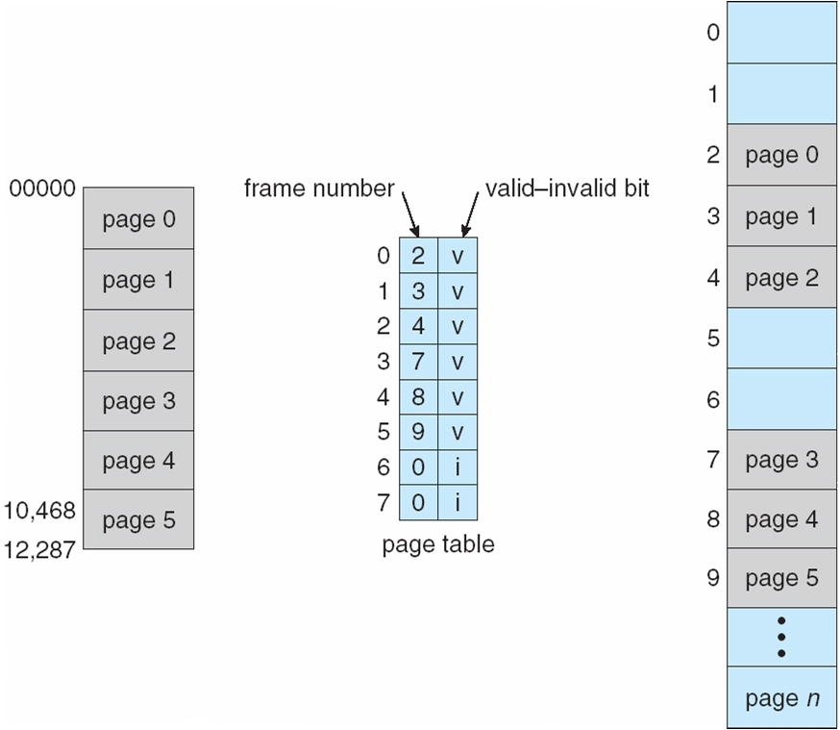
Memory Protection
Valid (v) or Invalid (i) Bit In A Page Table

Slide 12
Page Table Structure
Hierarchical Page Tables
Hashed Page Tables
Inverted Page Tables

Slide 13
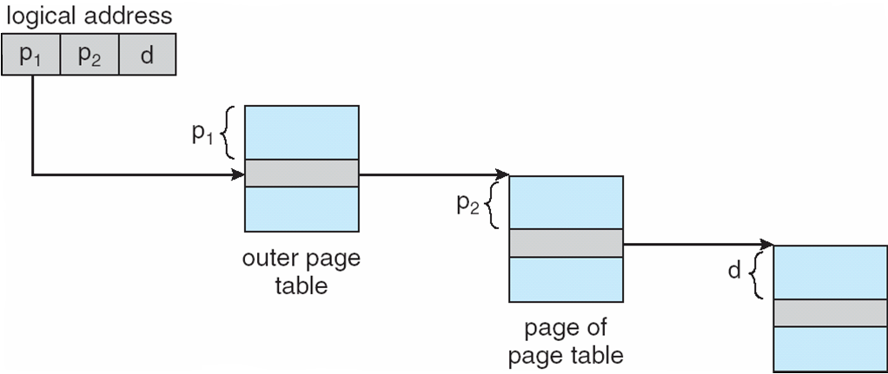
Hierarchical Page Tables
Break up the logical address space into multiple page tables
A simple technique is a two-level page table
Address-translation scheme for a two-level 32-bit paging architecture

Slide 14
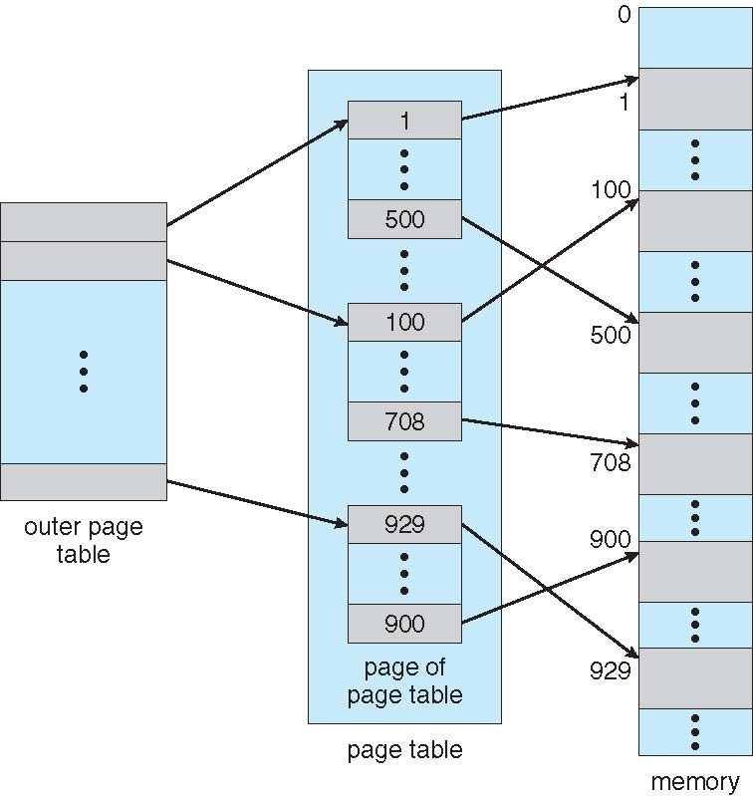
Hierarchical Page Tables - Two-Level

Slide 15
Hierarchical Page Tables - Two-Level
Two-Level Paging Example
A logical address (on 32-bit machine with 4K page size) is divided into:
a page number consisting of 20 bits
a page offset consisting of 12 bits
Since the page table is paged, the page number is further divided into:
a 10-bit page number
a 10-bit page offset
Thus, a logical address is as follows:
where p_{i} is an index into the outer page table, and p₂ is the displacement within the page of the outer page table
page number
page offset
p_{i}
p₂
d
10
10
12

Slide 16
Hierarchical Page Tables
64-bit Logical Address Space
Even two-level paging scheme not sufficient
If page size is 4 KB (2¹²)
Then page table has 2⁵² entries
If two level scheme, inner page tables could be 2¹⁰ 4-byte entries
Address would look like
Outer page table has 2⁴² entries or 2⁴⁴ bytes
One solution is to add a 2nd outer page table
But in the following example the 2nd outer page table is still 2³⁴ bytes in size
And possibly 4 memory access to get to one physical memory location
outer page
inner page
page offset
p₁
p₂
d
42
10
12

Slide 17
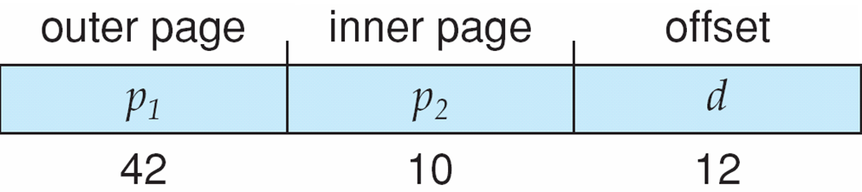
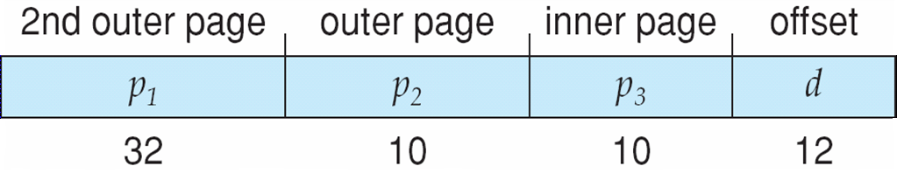
Hierarchical Page Tables - Three-level

Slide 18
Hashed Page Tables
Common in address spaces > 32 bits
The virtual page number is hashed into a page table
This page table contains a chain of elements hashing to the same location
Each element contains
the virtual page number
the value of the mapped page frame
a pointer to the next element
Virtual page numbers are compared in this chain searching for a match
If a match is found, the corresponding physical frame is extracted
Variation for 64-bit addresses is clustered page tables
Similar to hashed but each entry refers to several pages (such as 16) rather than 1
Especially useful for sparse address spaces (where memory references are non-contiguous and scattered)

Slide 19
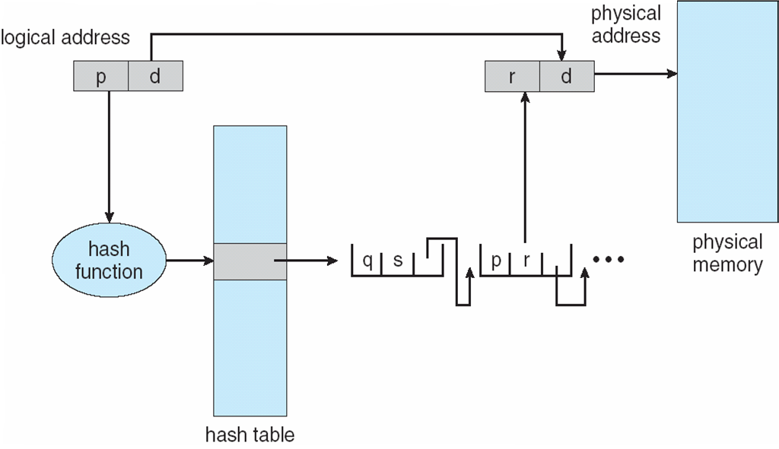
Hashed Page Table

Slide 20
Hashed Page Table example
frm 8
Page 5
Hash function ()
Page 14
Page 5
P5 f8 *P
P14 f12 *P
P15 f16 null
frm 12
Page 14

Slide 21
Inverted Page Table
Rather than each process having a page table and keeping track of all possible logical pages, track all physical pages
One entry for each real page of memory
Entry consists of the virtual address of the page stored in that real memory location, with information about the process that owns that page
Decreases memory needed to store each page table, but increases time needed to search the table when a page reference occurs
Use hash table to limit the search to one — or at most a few — page-table entries
TLB (translation look aside buffer) can accelerate access

Slide 22
Inverted Page Table
Rather than having multiple page tables for each process pages, one global page table.
Normally page table have the number of entries as per no. of pages a process have but in inverted page table the number of entries into page table are equal to the number of frames of memory

Slide 23
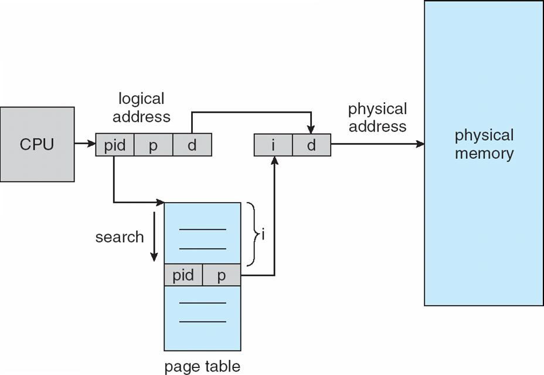
Inverted Page Table

Slide 24
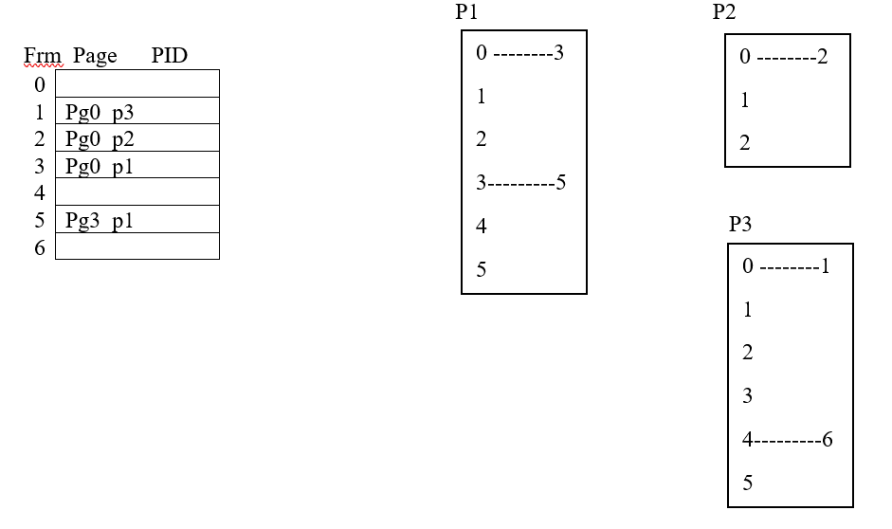
Inverted Page Table Example

Slide 25
Segmentation
Segmentation divides a process into variable length chunks called segments
Almost similar to variable sized partitions
Segment’s length is determined by the system
The segments defined by a programmer reflect the modular structure of the process
e.g. data in one segment and code in another segments

Slide 26
Segment Addressing
The segment address consist of two parts
The segment number s and
The displacement d within that segment
A process segment table entries specify the base address and the segment size
The address conversion process is similar to the paging system
A segmented address reference requires the following steps
Extract the segment number and the displacement from the logical address
Use the segment number to obtain the segment base address and length from segment table
Check that the offset is not greater than the given length; if so, an invalid address is signaled
Generate the required physical address by adding the offset to the base address

Slide 27
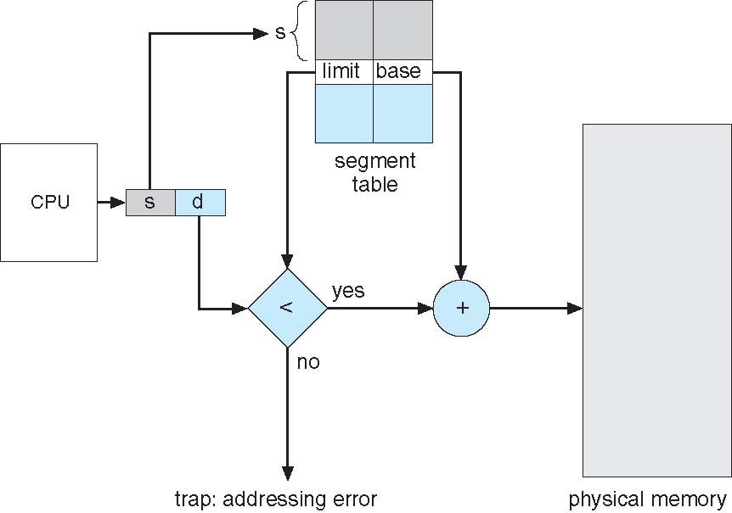
Segment Addressing

Slide 28
Segment Addressing
0
1400
2400
3200
4300
4700
5700
6300
6700
Segment 0
Segment Table
 | Limit | Base
0 | 1000 | 1400
1 | 400 | 6300
2 | 400 | 4300
3 | 1100 | 3200
4 | 1000 | 4700
Segment 3
Segment 2
Segment 4
Segment 1

Slide 29
Paging vs. Segmentation
Paging use small chunks ‘pages’ of same size
Segmentation use chunks ‘segments’ of variable sizes
Paging avoids fragmentation
Segmentation also improves allocation while preserving the process structure
Paging system is independent of programmer while segmentation reflects the logical structure of a process

Slide 30
Paging and Segmentation
A process can be loaded in separate parts (using segmentation or paging)
Memory address references can be translated dynamically at run time
Not necessary to load all pages of a process into memory
Load portions being referenced at time of execution
Rest is retained on secondary storage

Slide 31
Page Fragmentation
Calculating internal fragmentation
Page size = 2,048 bytes
Process size = 72,766 bytes
35 pages + 1,086 bytes
Internal fragmentation of 2,048 - 1,086 = 962 bytes
Worst case fragmentation = 1 frame – 1 byte
On average fragmentation = 1 / 2 frame size
So small frame sizes desirable?
But each page table entry takes memory to track
Page sizes growing over time
Solaris supports two page sizes – 8 KB and 4 MB
Process view and physical memory now very different
By implementation process can only access its own memory

Slide 32
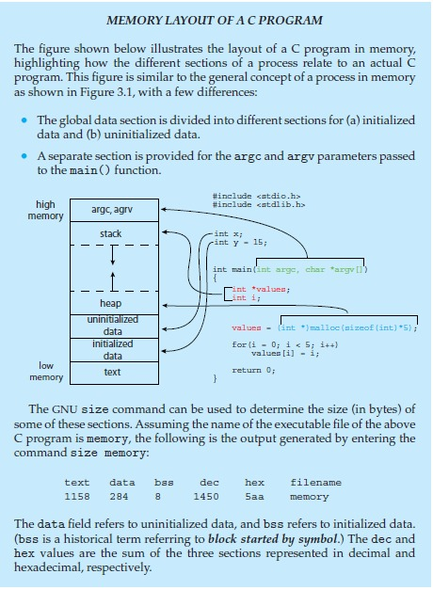
Memory Layout of a C Program

Slide 33
Memory Layout of a C Program
Memory Segments
The memory for a C program is divided into several segments:
Text Segment: This is where the actual compiled code of the program is stored. It's typically read-only to prevent accidental modification of instructions.
Initialized Data Segment: Contains global and static variables that are initialized by the programmer. For instance, variables initialized with specific values are stored here.
Uninitialized Data Segment (BSS): Stores global and static variables that are declared but not initialized. The BSS section will be filled with zeroes by the operating system.
Heap: The area where dynamically allocated memory (e.g., memory allocated by `malloc`) is stored. It grows upwards, as memory is requested at runtime.
Stack: This section stores local variables and function call information. It grows downwards, adding and removing frames as functions are called and returned.
Arguments (`argc` and `argv`): Space for command-line arguments passed to “main(int argc, char *argv[])”.

Slide 34
Memory Layout of a C Program
The code and its Output
Declares two global variables `x` (uninitialized) and `y` (initialized to 15).
Allocates dynamic memory for an integer array `values` on the heap.
Iterates through the array, initializing `values[i]`.
Output of the `size` Command
The GNU `size` command is used to inspect memory usage in various segments. The example output in the figure shows:
text: 158 bytes - Code for the executable program.
data: 284 bytes - For initialized global/static variables.
bss: 1450 bytes - For uninitialized global/static variables.
The command gives the size of each segment in decimal (dec) and hexadecimal (hex) formats.

